Slide 1

“Todo Planner”
Task - 3

Slide 2
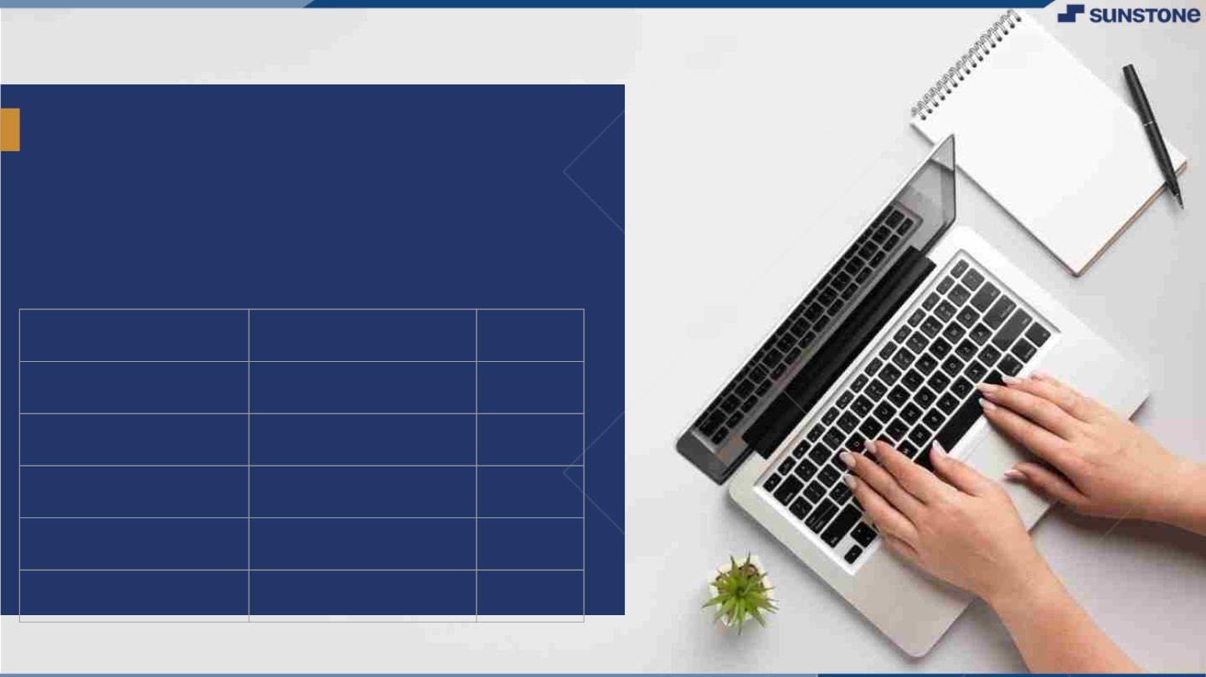
Todo Planner
Chat applications leverage a range of technical components and protocols to function effectively. They rely on a client-server architecture, enabling communication between users and a central server that stores and relays messages. Real-time communication protocols ensure instant message delivery, while robust data encryption techniques safeguard the privacy and security of transmitted information..
▪
LMS Username
Name
Batch
EBF115B500AB040882341A72B5819654
K Yuvraj
CA9
600445987D72D9EB4B043116A0B441B1
CA9
B Veeresh
F7EA8E34DB90511B42F456C5A4110D1B
Dilli G
CA9
EBF115B500AB040882341A72B5819654
CA9
B Monish

Slide 3
Task 3 :: Frontend Creation
Create various Front End Programs
Draw and design a uniform front end code for “Your Project”
Draw and design a interactive front end code for “Your Project”
Evaluation Metric:
100% Completion of the above tasks
Learning outcome
Developing complicated UI using HTML components
Using props drilling and context to pass variables
Getting familiar with different type of api calls
Handling different input data

Slide 4

Step-Wise Description
1.Set up the React Project
2.HTML Structure
3.CSS Styling
4.Java Script Intractivity
5.Resposive Design
6.Frame Work and Libraries
7.User input handling
8.API integration
9.Testing and Debugging
10.Deploying the Application
Summary of your task
Creating various front-end programs involves building the user interface of applications through a combination of HTML, CSS, and JavaScript. Beginning with the HTML structure, developers define the layout and elements of the web page. CSS is then applied to style these elements, allowing for customization of colors, fonts, and layout. JavaScript is incorporated to add interactivity and handle user events. Responsive design techniques ensure adaptability to different screen sizes.

Slide 5
Assessment Parameter
Create folder structure for Todo Planner application
Render Conditional components
Write Functions for event handling
Check-List
Overall UI of the project
Handling broken links
Optimizing render cycle

Slide 6
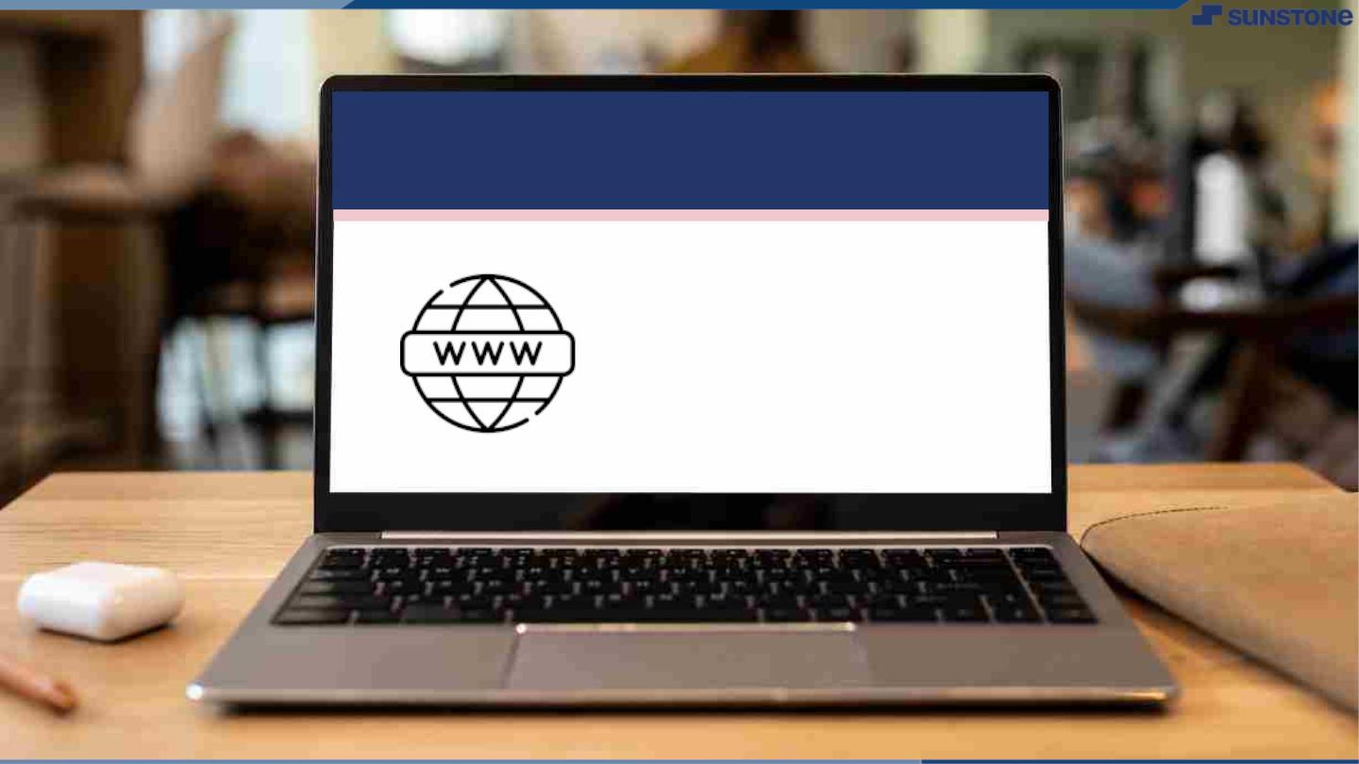
Submission Github
https://github.com/rajuroyal-web/online-chat-application-

Slide 7


